Slide 1
ME 3101 Project
Image Processing of Droplet Dynamics on a Superhydrophobic Surface
Name: NISHTHA SHRIVAS
Roll No.: 2403ME03

Slide 2

MY APPROACH
Why this approach?
-Separates the droplet from the background
-Removes unwanted small regions
-Tracks the droplet frame-by-frame
-Allows geometric and motion measurements
High-Speed Video
↓
Extract Frames
↓
Convert to Grayscale
↓
Crop Region of Interest
↓
Gaussian Filtering
↓
Thresholding
↓
Remove Small Objects
↓
Connected Component Analysis
↓
Detect Droplet
↓
Track Geometry & Motion
↓
Calculate Required Quantities

Slide 3
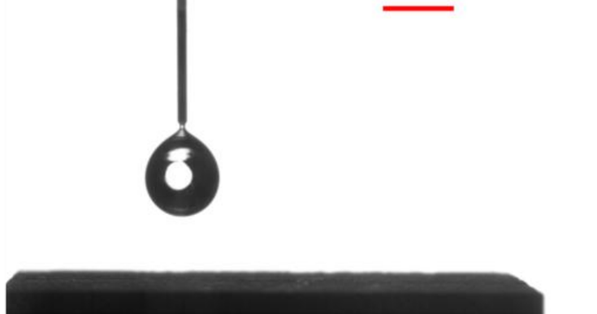
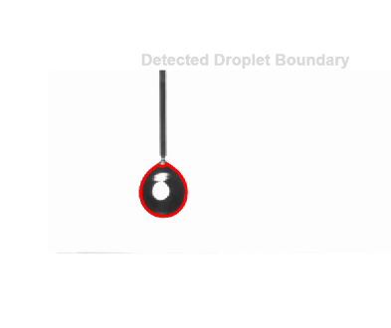
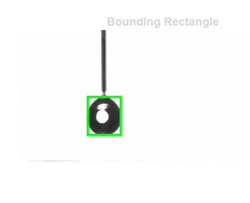
DROPLET DETECTION
Key choices:
--Grayscale conversion
--Gaussian filtering
--Thresholding
--Removal of small objects
--Largest connected component selected as droplet
Fig 2: detected droplet boundary
Fig 3: bounding rectangle
Figure1 : raw image

Slide 4
3. Tracking & Measurements
Droplet
┌───────────┐
│ • │ ← Centroid |
Y ↕ | |
└───────────┘
←── X ───→
Tracked quantities
Bounding box
X diameter
Y diameter
Centroid position
Top boundary
Bottom boundary
Calibration
50 pixels = 2mm

Slide 5
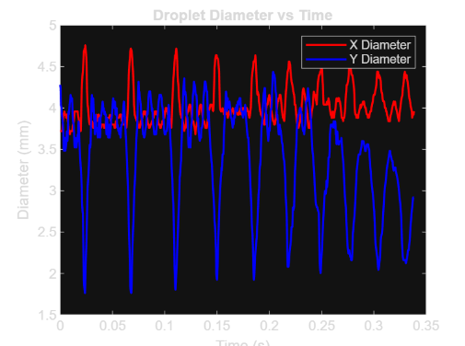
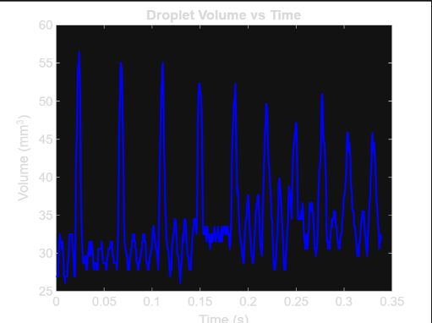
Key Results: Droplet Geometry
Observation: X and Y diameters change during impact and rebound, showing droplet deformation.
Observation: Estimated volume varies because the droplet is not perfectly spherical during deformation

Slide 6
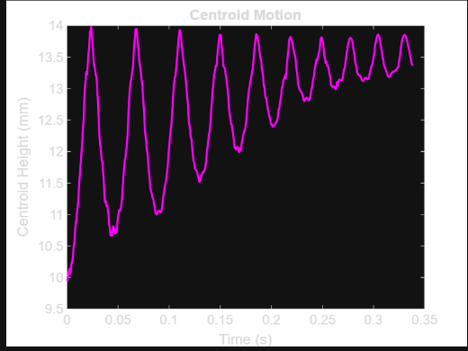
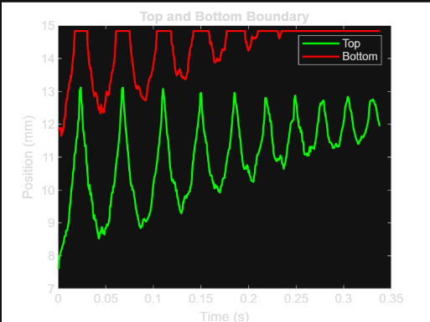
KEY RESULTS: MOTION & BOUNCE
Centroid Motion
Top and Bottom Boundary
Motion stages :
Free fall → Impact → Rebound → Oscillation
Number of bounces:
48

Slide 7
Analysis & Interpretation
Deformation
The droplet spreads and becomes flatter during impact, then becomes more spherical during rebound.
Impact & Rebound
The droplet's downward motion changes rapidly during impact and reverses during rebound.
Energy Loss
Some kinetic energy is converted into droplet deformation and lost through processes such as viscous effects and interaction with the surface.
Superhydrophobic Behaviour
The droplet's rebound indicates low interaction with the water-repellent surface.

Slide 8
Method Evaluation & Conclusions
What worked
Droplet was successfully detected from the video.
Boundary and bounding box were obtained.
Droplet geometry and motion were tracked.
Bounce behaviour could be identified.
Limitations / Errors
Threshold selection can affect detection.
Image noise can affect the boundary.
Calibration affects measured dimensions.
Spherical assumption affects volume estimation.
Conclusion
Image processing successfully tracked the droplet.
The droplet undergoes significant deformation during impact.
The droplet rebounds from the superhydrophobic surface.
Better segmentation and shape-based volume estimation could improve accuracy.

